Slide 1


Kationische Nanopartikelformulierungen mit dsRNA als zielspezifisches Pflanzen-schutzmittel
Benjamin W. Moorlach¹, Desiree Jakobs-Schönwandt¹, Minna Poranen², Karl-Heinz Kogel³, Manfred Heinlein⁴, Anant V. Patel¹
¹Fachhochschule Bielefeld, Germany
²University of Helsinki, Finland
³Justus Liebig Universität, Germany
⁴Centre National de la Recherche Scientifique, France

Slide 2
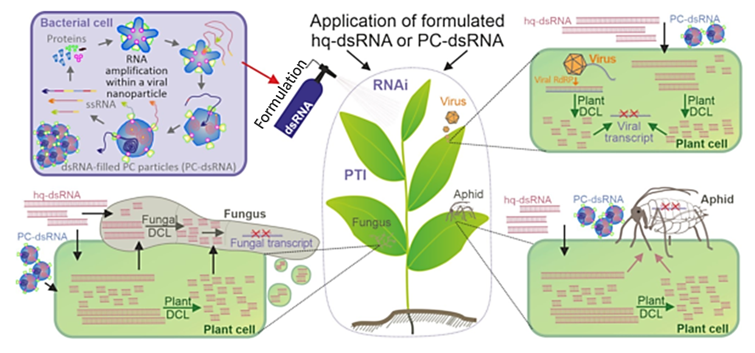
dsRNA as a pesticide - RNAi
Notes:
Top Left: Finland‘s dsRNA production system: high quality dsRNA are produced in Pseudomonas bacteria within phi6 polymerase complex particles (PCs). → treatment with purified dsRNA or with encapsidated dsRNA
RNA interferenz zielspezifisch gegen: Pilze, Viren und Insekten
Chemische Pestizide ersetzten mit einer sicheren, kosteneffektiven und nachhaltigen Alternative, um auch in Zukunft die Lebensmittelversorgung zu sichern.

Slide 3
dsRNA as a pesticide - RNAi
dsRNA is a natural molecule that activates RNAi, a evolutionarily highly preserved pathway in eukaryotes, which regulates gene expression via mRNa degradation or repression of translation¹
dsRNA is highly target specific on the nucleotide sequence → tailored towards specific pathogens and non-toxic towards all other organism
Uptake into plant leaves and consecutively entry into plants cells is necessary for the RNAi pathway to activate.
[1] Yan, et al. 2021
Notes:
For example: Fungal infection of plants. The dsRNA is processed to siRNAs by DICERS in the plant or in the fungus directly. The siRNA form RISC (RNA induced silencing complex) and cleave vital mRNAs, i.e. silence vital gene expression.
GMOs: corn/maize rootworm resistant GM maize (MON87411), SmartStax™ maize with multiple resistance traits, including dsRNA against Diabrotica virgifera virgifera
cassava resistant to Brown Streak Virus and Ugandan Cassava Brown Stick Virus in Nigeria
common bean resistant to Bean Golden Mosaic Virus
papaya resistant to Papaya Ringspot Virus
plum tree resistant to plum pox virus
RISC = RNA induced silencing complex

Slide 4
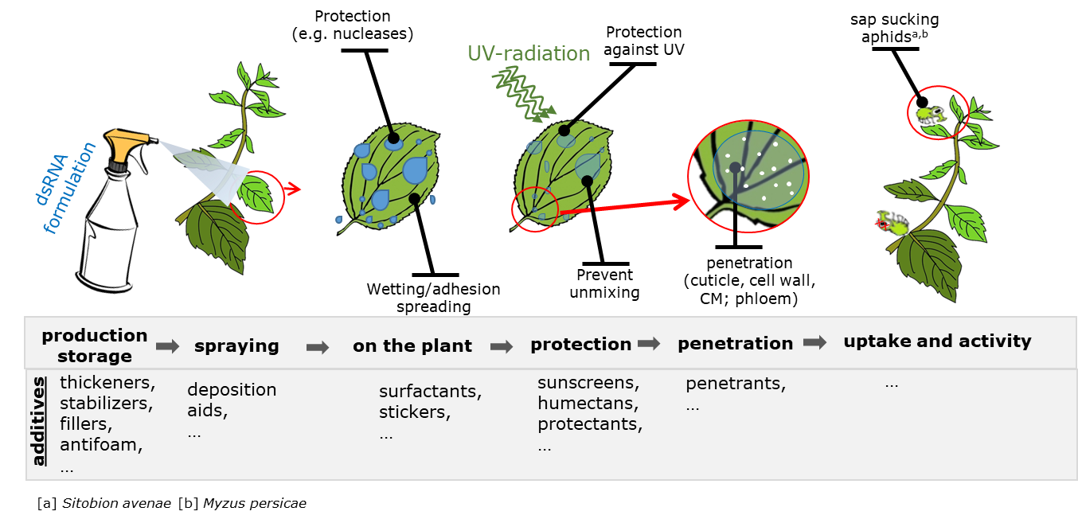
Foliar application of formulated dsRNA
Particle size and shape, charge, coatings
→ release of dsRNA into cytoplasm
Notes:
MAJOR challenges for non-GMO dsRNA approach for Aphids: dsRNAs or siRNAs must enter the Phloem so they are taken up by aphids during feeding (Aphids feed on the Phloem sap). Effectiveness of dsRNA against aphids has been demonstrated in GMO-approach, in which the dsRNA is expressed by genetically modified plants.

Slide 5

State of the Art – dsRNA Formulation
Recent advances in nanoformulation of RNA towards targeted delivery²
Only few attempts in agriculture have been undertaken^{2,3}
All approaches mask negative charge of naked dsRNA to facilitate cell uptake:
  guanylate polymers⁴
  “BioClay” nanosheets⁵⁻⁷
  cationic oligopeptide⁸, -bound to a cell-penetrating peptide⁹
  cationic fluorescent nanoparticle¹⁰
  complex DNA origami nanostructure^{11,12}
  anucleated minicells¹³
  encapsulation in liposome complexes¹⁴
  gold nanoparticle^{15,16}
Our formulation goal:
An innovative formulation based on biologically degradable ingredients that:
delivers the dsRNA to plant leaves
stabilizes and protects dsRNA on the leaves
supports long-lasting uptake and subsequent release of dsRNA into the plant cytoplasm

Slide 6

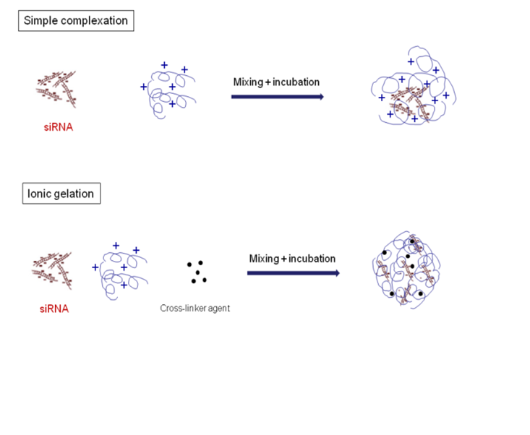
Formulation development
Create a formulation, which
  masks the negative charge of dsRNA.
  protects and stabilizes dsRNA.
(charge mask [passive uptake] / positive charge [stick to cell membrane→ endocytosis])
First step: Nanoformulation
next step: Spray formulation
Surfactants, antifoam,
fillers, stabilizers, thickeners, deposition aids, penetrants, abrasives, humectants, protections . . .
Formulation process
dsRNA
Phosphate groups
Cationic Biopolymer
hq-dsRNA (Phi 6) with short,medium and long fragments, ~ 3000 , 4000, and 7500 nt respectively
Formulation nanoparticles

Slide 7
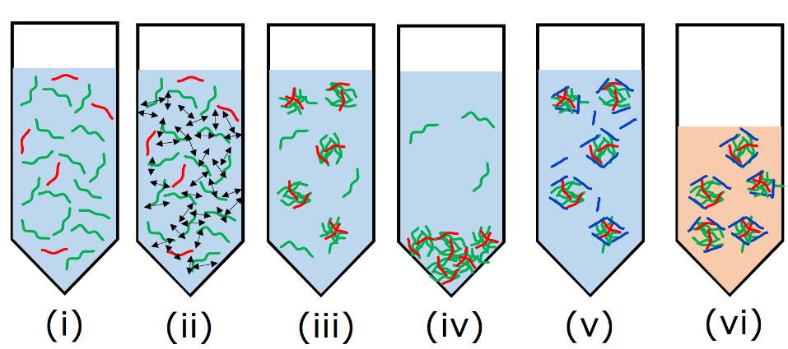
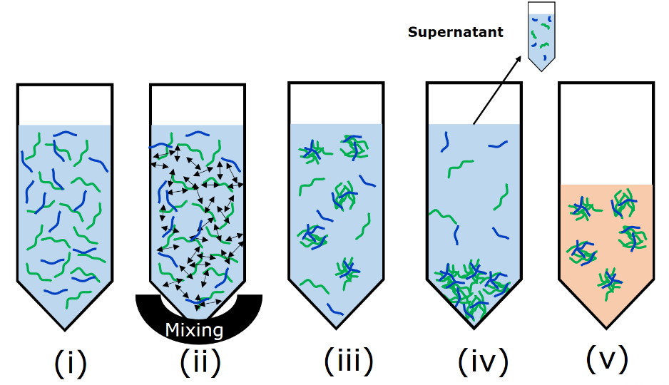
dsRNA formulation methods
A
Cationic biopolymer/ crosslinker
Formulation medium
anionic crosslinker
Carrier/ storage medium
dsRNA
Main principle: Interaction of cationic polymers with anionic dsRNA to form nanoparticles.
Factors: energy input, temperature of solutions, incubation time, solution concentration, charge ratios of components, polymer charge and molecular weight, formulation medium
Not all steps are shown
B
Not all steps are shown

Slide 8
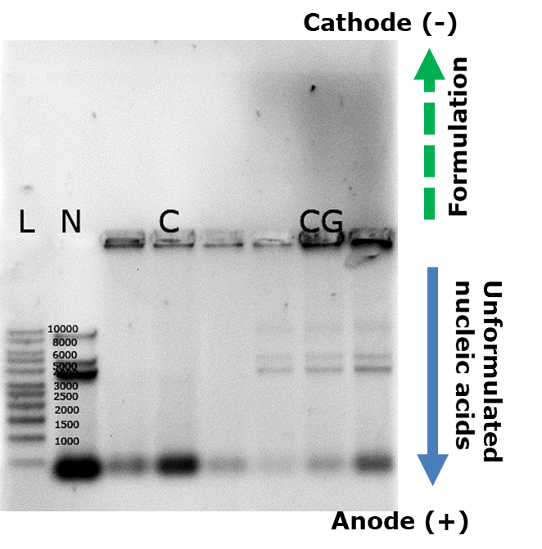
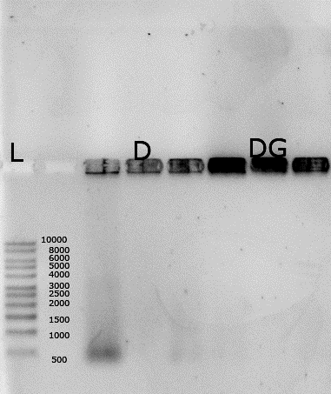
Charge of the formulations
Hypotheses:
Cationic biopolymers will electrostatically interact with anionic, i.e. negatively charged dsRNA and form nanoparticles.
The dsRNA-biopolymer formulation will be chargeless or positively charged.
Results:
Some formulations migrate to the cathode → positive charge
Agglomerates or chargeless particles remain in the gel pockets
Some formulations are more stable than others
Electrophoretic light scattering results:
The zeta potential of our formulations range from +29 to 47 mV
(at pH 5.5, electric field 15.80 V/cm, viscosity of 0.88 cP, refraction index of 1.33, dielectric constant 78.3, with Delsa Nano C, Beckman Coulter).
8
Notes:
Figure: hq-dsRNA formulated with chitosan from Sigma-Aldrich. L is 1 kb DNA ladder from Roth. N is naked dsRNA as a control. ROTI®GelStain was included in the 1 % agarose gel. In CG the dsRNA was formulated the same as C, but ROTI®GelStain was added during the formulation process.

Slide 9

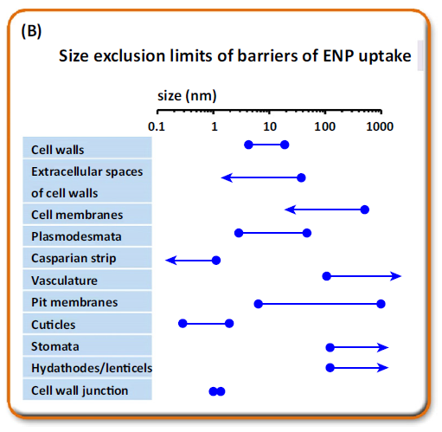
Nanoparticle size and size distribution
Formulation A
DLS Experiment:
hq-dsRNA are loaded onto cationic nanoparticles to improve uptake.
Size and charge are major factors.
cationic biopolymer
anionic crosslinker
dsRNA
Formulation medium
Carrier medium
Hydrodynamic diameter in nm
Wang, et al. Trends in plant science (2016)
Results:
23,1 ± 31,94 nm to 161,9 ± 165,8 nm after loading with dsRNA
Notes:
DLS results of the formulation created with the Nanoparticle first method. The hydrodynamic diameters were determined before (NPs) and after loading with dsRNA (loaded NPs). The hydrodynamic diameter increased from 23,1 ± 31,94 nm to 161,9 ± 165,8 nm after loading with dsRNA.

Slide 10
Size of the formulation – scanning electron microscopy
Notes:
Keine Kritisch-Punkttrocknung → Stattdessen, Trocknung von wenigen µL Nanopartikel Suspension (Colloidale Suspension)
Besplatterung mit Ruthenium

Slide 11
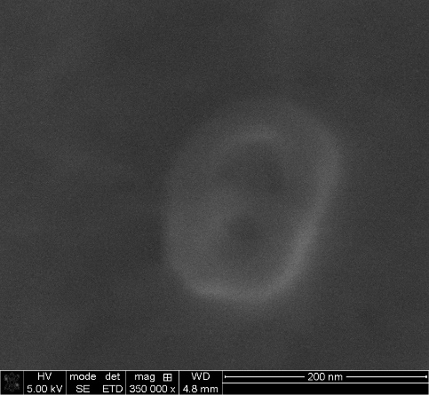
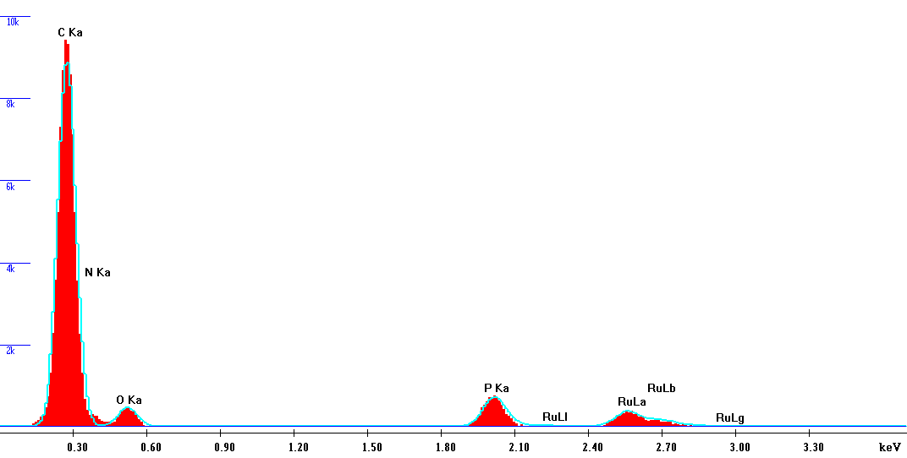
Formulation – nanoparticle size
Experiment:
The formulation nanoparticles were investigated with DLS, SEM and EDX for size, size distribution and composition.
Phosphorus peak
Results:
DLS 161,9 ± 165,8 nm and PDI of 0.2 – 0.35 (depending on formulation treatment)
SEM confirmed particle sizes of 150 – 200 nm
Some formulations are more stable than others
The presence of phosphorus in EDX confirmed the presense of dsRNA in our formulation

Slide 12
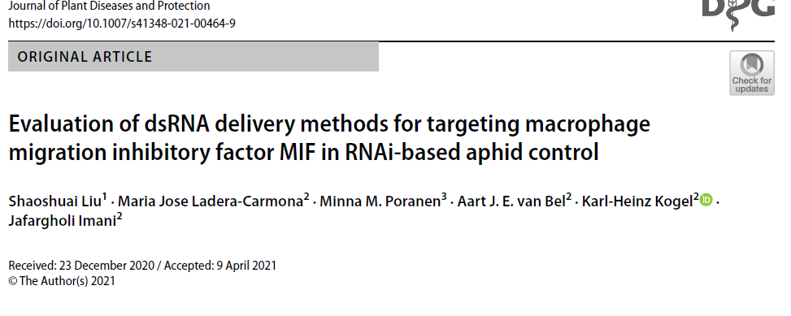
Outlook
Uptake and localization experiments as well as RNAi functionality of our dsRNA formulations will be tested on Verticillium longisporum in liquid culture and Arabidopsis thaliana and compared to free dsRNA
  Foto von JLU
Further optimization of size and charge of our nanoformulations
Development of the carrier liquid for spray application: Surfactants, antifoam, penetetrants, …
Upscaling the dsRNA production (Phi 6 polymerase in bacterial host)
Notes:
Background: Aphids Sitobion avenae, Myzus persicae feed on the rich phloem sap. Therefore, dsRNA or siRNAs must be present in phloem sap to effectively target aphids.
(Liu et al 2021) Figure: Uptake of labeled dsRNA into Arabidopsis thaliana petioles and leaves. Confocal images of the reporter line SUC2::YFP. a–h cut petiole ends were submerged for 24 h in nuclease-free water containing 20 μM 21-nt siRNACy3 and cross sections were examined at the base (a–d) and in the middle of the petiole (e–h). i–l leaves were dropped with 21 nt dsRNACy3 (20 μM) for 24 h. Images were taken with a confocal microscope from different segments of the petiole. The red color, which is restricted to the xylem vessels, represents Cy3 fluorescence (λexc561nm, λem566–635 nm) and the green color represents the phloem-based YFP fluorescence (λexc514 nm, λem519–551 nm). xy, xylem; ph, phloem
YFP-labeled Arabidopsis reporter lines (expresses YFP shown green in the image) show that fluorescent 21 nt dsRNA(Cy3) applied to petioles or by spraying is present in xylem but not in the phloem. The dsRNA, which is labeled with cy3 (red) is present in the xylem.
These results indicate that mere application of naked dsRNA onto plants for aphid control is inefficient and that effective dsRNA formulations are needed to enter the phloem.

Slide 13
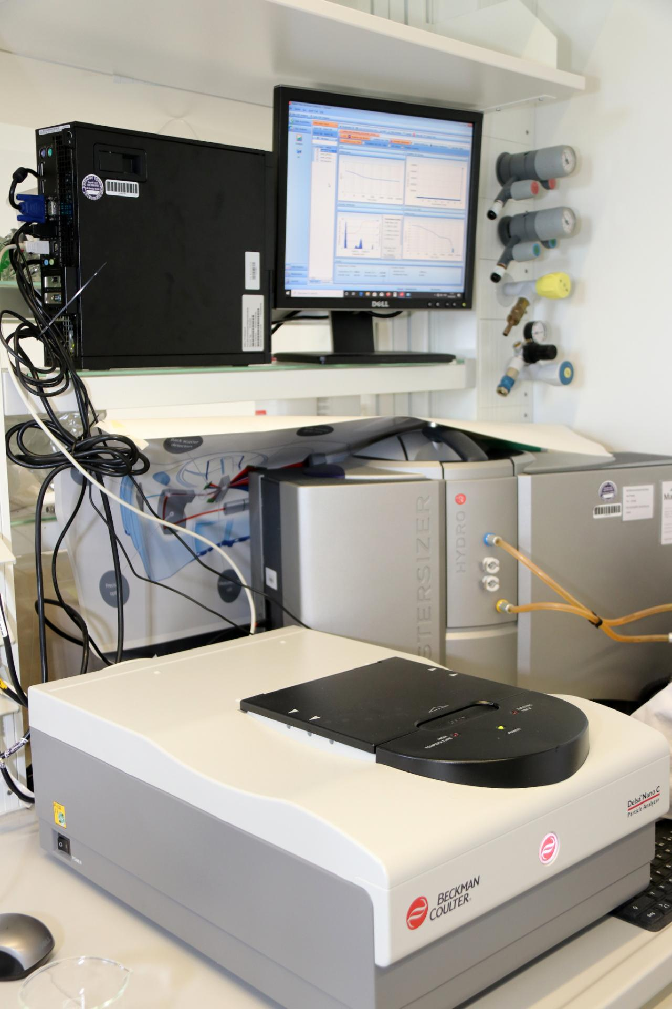
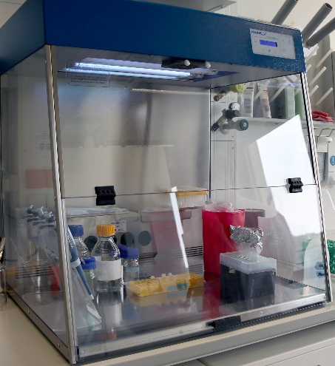
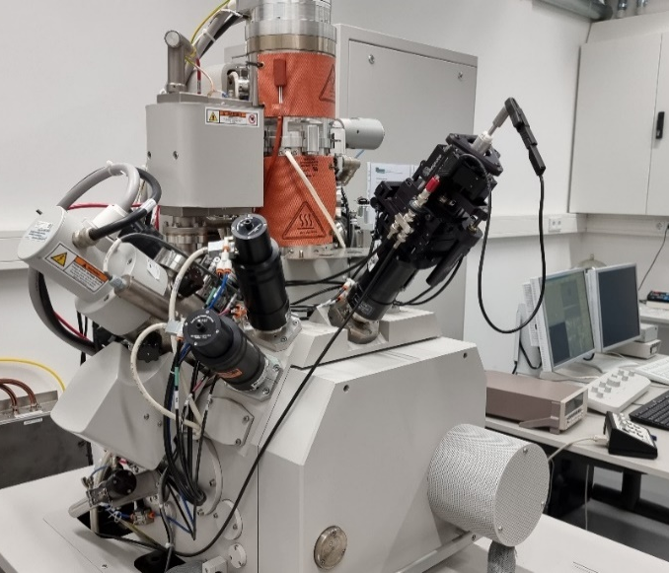





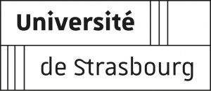
Vielen Dank für die Aufmerksamkeit.

Slide 14
literature
[1] Yan, S., Ren, B.-Y., Shen, J., Nanoparticle-mediated double-stranded RNA delivery system: A promising approach for sustainable pest management. Insect Science 2021, 28, 21-34.
[2] Rank, A. P., Koch, A., Lab-to-Field Transition of RNA Spray Applications - How Far Are We? Frontiers in Plant Science 2021, 12.
[3] Vurro M, Miguel-Rojas C, Perez-de-Luque A: Safe nanotechnologies for increasing the effectiveness of environmentally friendly natural agrochemicals. Pest Manag Sci 2019, 75:2403-2412.
[4] Christiaens, O., Tardajos, M. G., Martinez Reyna, Z. L., Dash, M., et al., Increased RNAi Efficacy in Spodoptera exigua via the Formulation of dsRNA With Guanylated Polymers. Front Physiol 2018, 9, 316.
[5] Mitter, N., Worrall, E. A., Robinson, K. E., Xu, Z. P., Carroll, B. J., Induction of virus resistance by exogenous application of double-stranded RNA. Curr Opin Virol 2017, 26, 49-55.
[6] Worrall, E. A., Bravo-Cazar, A., Nilon, A. T., Fletcher, S. J., et al., Exogenous Application of RNAi-Inducing Double-Stranded RNA Inhibits Aphid-Mediated Transmission of a Plant Virus. Front Plant Sci 2019, 10, 265.
[7] Mosa, M. A., Youssef, K., Topical delivery of host induced RNAi silencing by layered double hydroxide nanosheets: An efficient tool to decipher pathogenicity gene function of Fusarium crown and root rot in tomato. Physiol. Mol. Plant Pathol. 2021, 115, 16.
[8] Unnamalai, N., Kang, B. G., Lee, W. S., Cationic oligopeptide-mediated delivery of dsRNA for post-transcriptional gene silencing in plant cells. Febs Lett 2004, 566, 307-310.
[9] Numata, K., Ohtani, M., Yoshizumi, T., Demura, T., Kodama, Y., Local gene silencing in plants via synthetic dsRNA and carrier peptide. Plant Biotechnol J 2014, 12, 1027-1034.
[10] Jiang, L., Ding, L., He, B. C., Shen, J., et al., Systemic gene silencing in plants triggered by fluorescent nanoparticle-delivered double-stranded RNA. Nanoscale 2014, 6, 9965-9969.
[11] Zhang, H., Demirer, G. S., Zhang, H., Ye, T., et al., DNA nanostructures coordinate gene silencing in mature plants. Proc Natl Acad Sci U S A 2019, 116, 7543-7548.
[12] Zhang, H., Zhang, H. L., Demirer, G. S., Gonzalez-Grandio, E., et al., Engineering DNA nanostructures for siRNA delivery in plants. Nat Protoc 2020, 15, 3064-3087.
[13] Islam, M. T., Davis, Z., Chen, L. S., Englaender, J., et al., Minicell-based fungal RNAi delivery for sustainable crop protection. Microb Biotechnol 2021, 14, 1847-1856.
[14] Taning CNT, Christiaens O, Li X, Swevers L, Casteels H, Maes M, Smagghe G: Engineered flock house virus for targeted gene
suppression through RNAi in fruit flies (Drosophila melanogaster) in vitro and in vivo. Front Physiol 2018, 9:805.
[15] Huan Zhang, Yuhong Cao, Dawei Xu, Natalie S. Goh, Gozde S. Demirer, et al., Gold-Nanocluster-Mediated Delivery of siRNA to Intact Plant Cells for Efficient Gene Knockdown Nano Letters 2021 21 (13), 5859-5866
[16] Zhang, H., Goh, N.S., Wang, J.W. et al. Nanoparticle cellular internalization is not required for RNA delivery to mature plant leaves. Nat. Nanotechnol. 17, 197–205 (2022)

